Slide 1




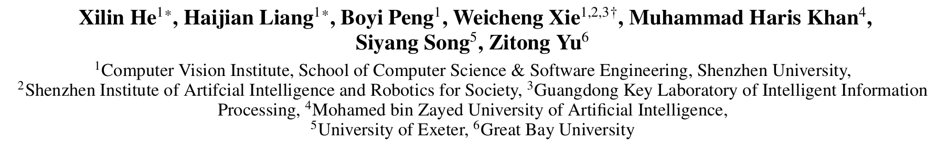





ATAI
Advanced Technique of Artificial Intelligence
ATAI
ChongqingUniversity _{AdvancedTechniqueof}
of Technology Artificial Intelligence
Chongqing University of
Technology
Chongqing University ^{ATAI}
_{of Technology} Advanced Techniqueof
Artificial Intelligence
Chongqing University of Technology
Chongqing University of Technology
MSAmba:Exploring Multimodal Sentiment Analysis with
State Space Models
Code : None.
—— AAAI’2025
Reported by Yang Jiang
1

Slide 2
ATAI
Advanced Technique of Artificial Intelligence
ATAI
ChongqingUniversity _{AdvancedTechniqueof}
of Technology Artificial Intelligence
Chongqing University of
Technology
Chongqing University ^{ATAI}
_{of Technology} Advanced Techniqueof
Artificial Intelligence
Chongqing University of Technology
Chongqing University of Technology
Introduction
1.the above-mentioned methods mainly rely on the abundant utilization of Transformers or convolution neural networks to achieve either long-range sequential modeling or cross-modal interaction, leading to an excessive number of parameters and low inference speed.
2.However, existing research on Mamba has primarily focused on single-modality learning, leaving multimodal fusion with Mamba unexplored, which is crucial for the task of MSA.

Slide 3
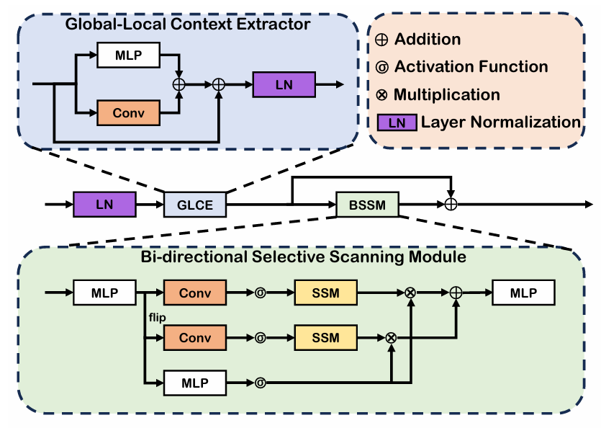
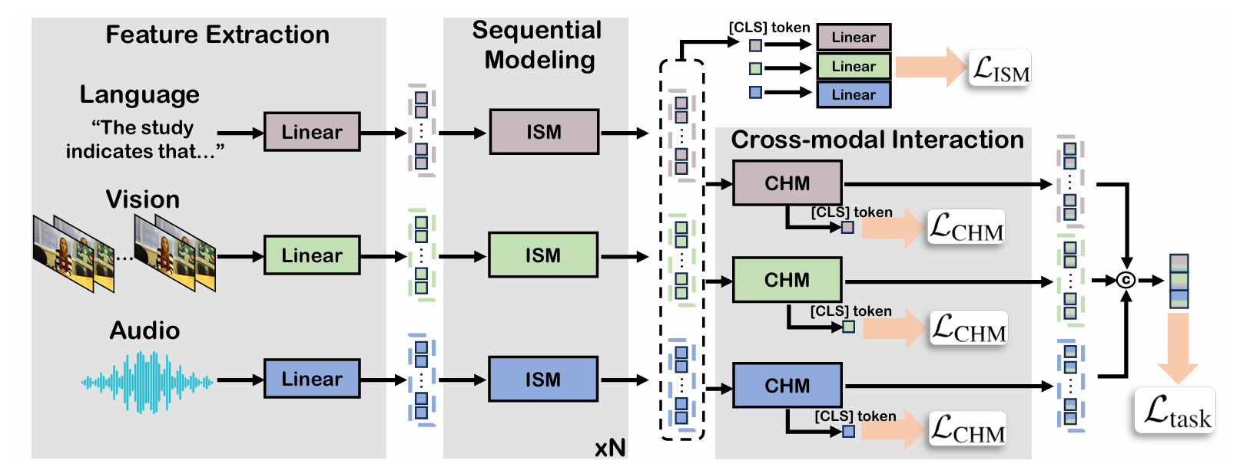
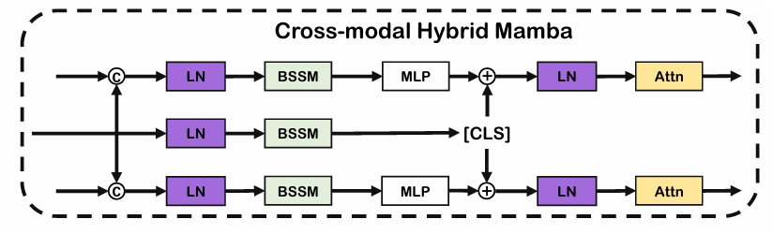
ATAI
Advanced Technique of Artificial Intelligence
ATAI
ChongqingUniversity _{AdvancedTechniqueof}
of Technology Artificial Intelligence
Chongqing University of
Technology
Chongqing University ^{ATAI}
_{of Technology} Advanced Techniqueof
Artificial Intelligence
Chongqing University of Technology
Chongqing University of Technology
Overview

Slide 4
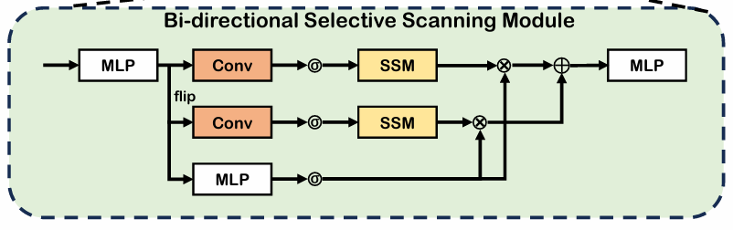
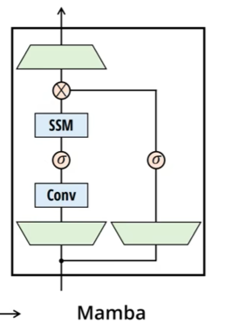
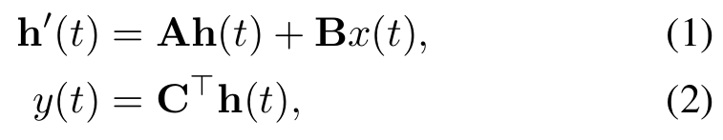
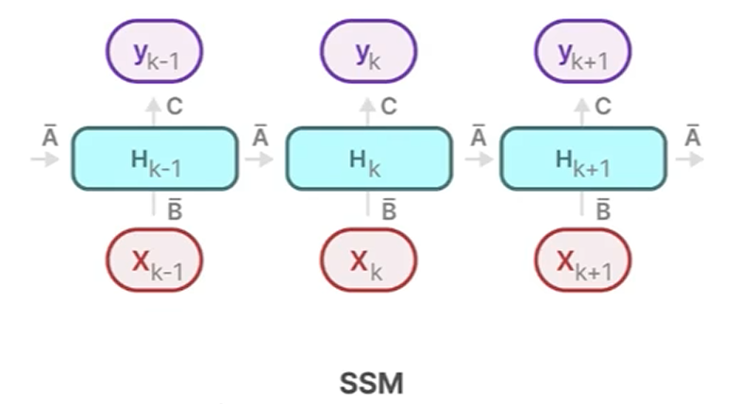
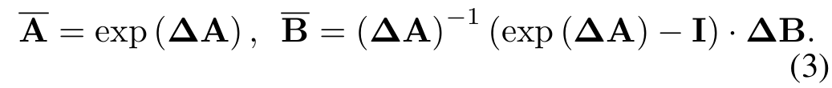

ATAI
Advanced Technique of Artificial Intelligence
ATAI
ChongqingUniversity _{AdvancedTechniqueof}
of Technology Artificial Intelligence
Chongqing University of
Technology
Chongqing University ^{ATAI}
_{of Technology} Advanced Techniqueof
Artificial Intelligence
Chongqing University of Technology
Chongqing University of Technology
Priliminary

Slide 5
ATAI
Advanced Technique of Artificial Intelligence
ATAI
ChongqingUniversity _{AdvancedTechniqueof}
of Technology Artificial Intelligence
Chongqing University of
Technology
Chongqing University ^{ATAI}
_{of Technology} Advanced Techniqueof
Artificial Intelligence
Chongqing University of Technology
Chongqing University of Technology
Method
Intra-modal Sequential Mamba

Slide 6


ATAI
Advanced Technique of Artificial Intelligence
ATAI
ChongqingUniversity _{AdvancedTechniqueof}
of Technology Artificial Intelligence
Chongqing University of
Technology
Chongqing University ^{ATAI}
_{of Technology} Advanced Techniqueof
Artificial Intelligence
Chongqing University of Technology
Chongqing University of Technology
Method
Cross-modal Hybrid Mamba

Slide 7
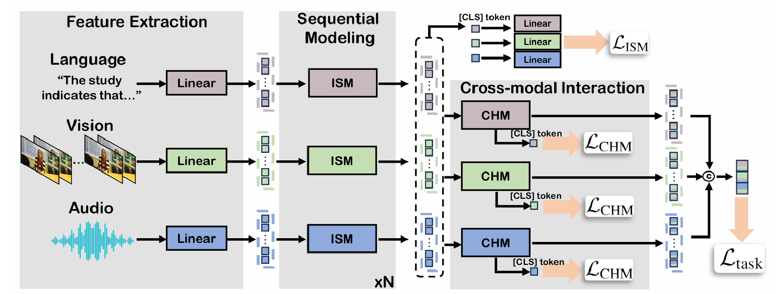


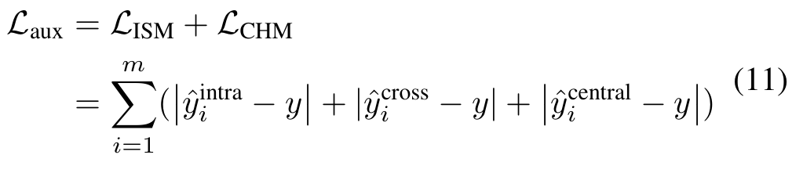
ATAI
Advanced Technique of Artificial Intelligence
ATAI
ChongqingUniversity _{AdvancedTechniqueof}
of Technology Artificial Intelligence
Chongqing University of
Technology
Chongqing University ^{ATAI}
_{of Technology} Advanced Techniqueof
Artificial Intelligence
Chongqing University of Technology
Chongqing University of Technology
Method

Slide 8
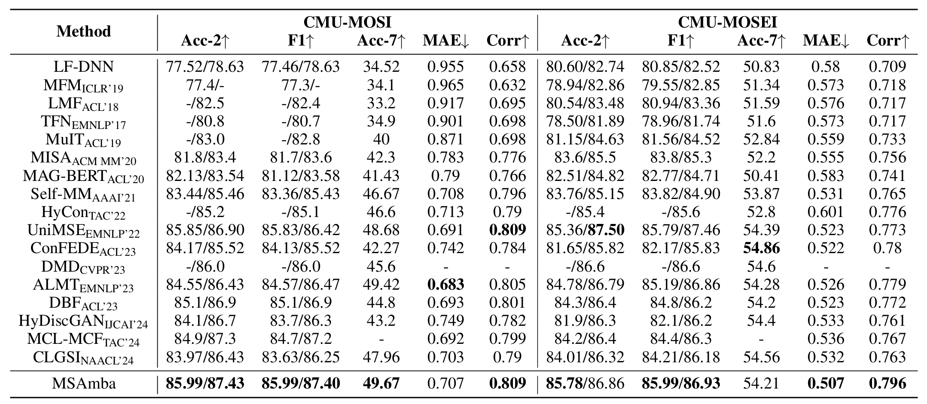
ATAI
Advanced Technique of Artificial Intelligence
ATAI
ChongqingUniversity _{AdvancedTechniqueof}
of Technology Artificial Intelligence
Chongqing University of
Technology
Chongqing University ^{ATAI}
_{of Technology} Advanced Techniqueof
Artificial Intelligence
Chongqing University of Technology
Chongqing University of Technology
Experiments

Slide 9
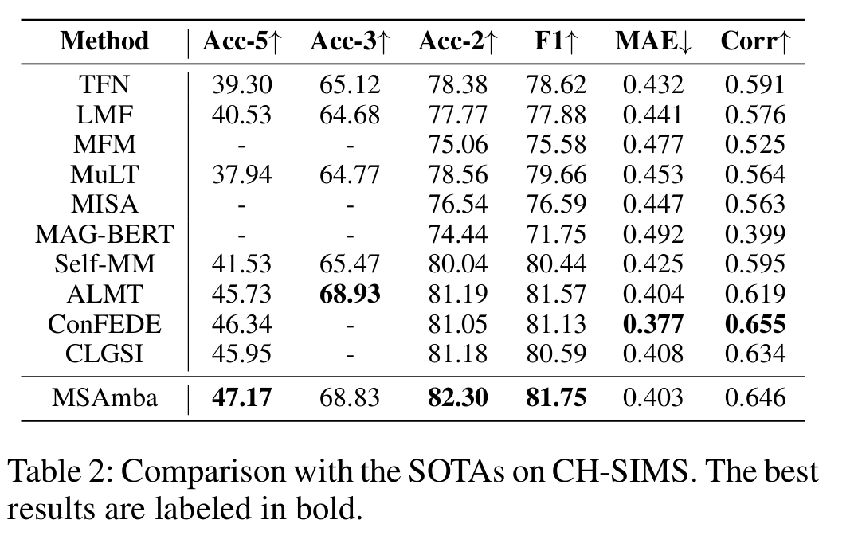
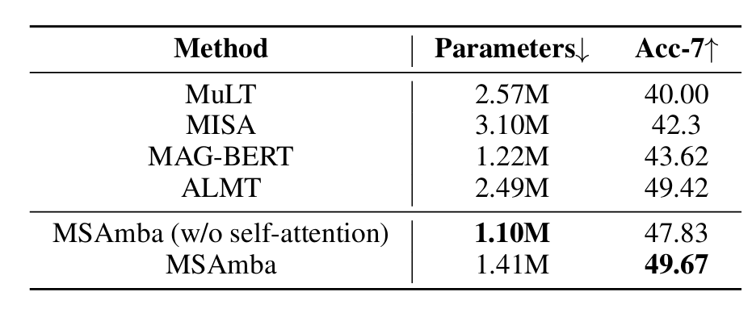
ATAI
Advanced Technique of Artificial Intelligence
ATAI
ChongqingUniversity _{AdvancedTechniqueof}
of Technology Artificial Intelligence
Chongqing University of
Technology
Chongqing University ^{ATAI}
_{of Technology} Advanced Techniqueof
Artificial Intelligence
Chongqing University of Technology
Chongqing University of Technology
Experiments

Slide 10
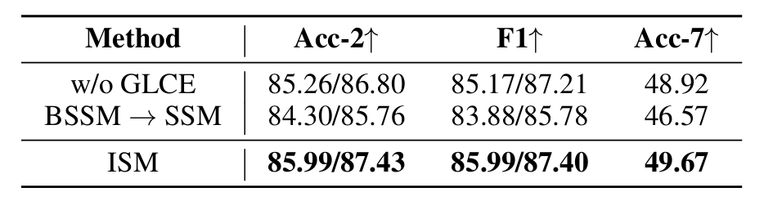
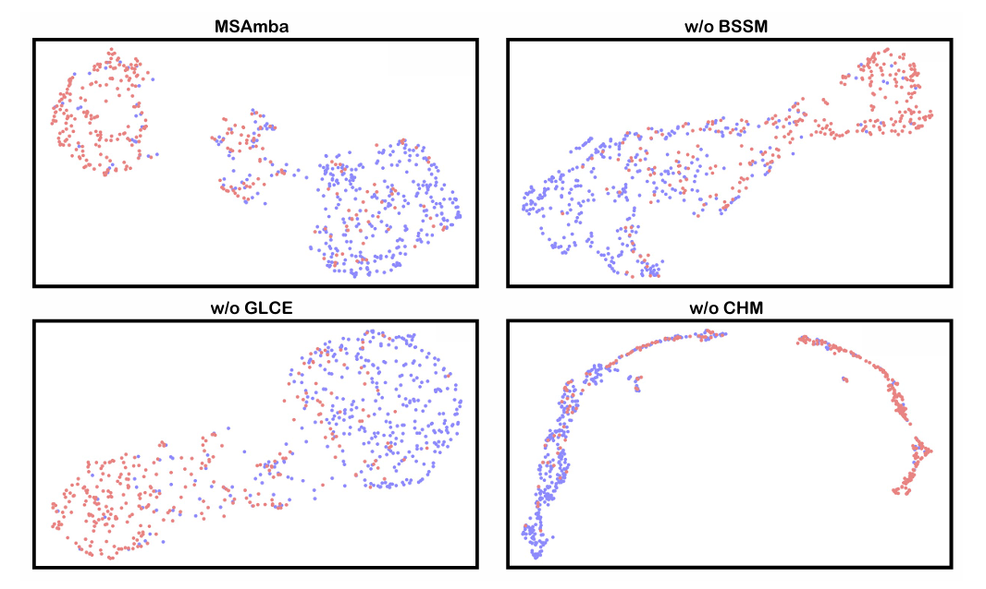
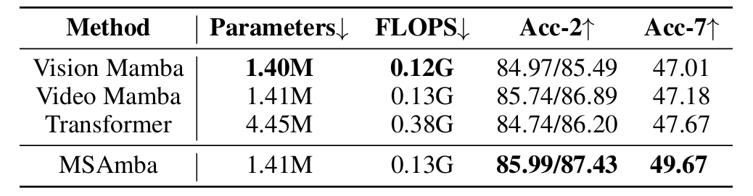
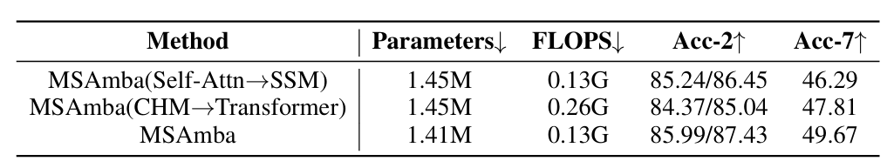
ATAI
Advanced Technique of Artificial Intelligence
ATAI
ChongqingUniversity _{AdvancedTechniqueof}
of Technology Artificial Intelligence
Chongqing University of
Technology
Chongqing University ^{ATAI}
_{of Technology} Advanced Techniqueof
Artificial Intelligence
Chongqing University of Technology
Chongqing University of Technology
Experiments

Slide 11
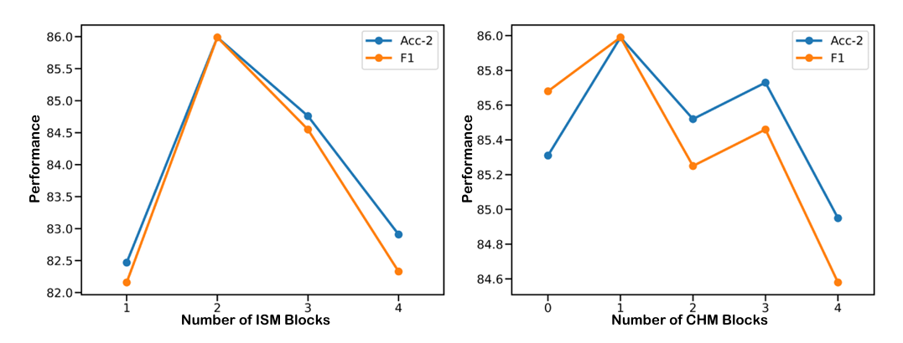
ATAI
Advanced Technique of Artificial Intelligence
ATAI
ChongqingUniversity _{AdvancedTechniqueof}
of Technology Artificial Intelligence
Chongqing University of
Technology
Chongqing University ^{ATAI}
_{of Technology} Advanced Techniqueof
Artificial Intelligence
Chongqing University of Technology
Chongqing University of Technology
Experiments

Slide 12


ATAI
Advanced Technique of Artificial Intelligence
ATAI
ChongqingUniversity _{AdvancedTechniqueof}
of Technology Artificial Intelligence
Chongqing University of
Technology
Chongqing University ^{ATAI}
_{of Technology} Advanced Techniqueof
Artificial Intelligence
Chongqing University of Technology
Chongqing University of Technology
Thanks!

